Slide 1
GESTURE RECOGNIZATION SYSTEM FOR MUTE PEOPLE
Submitted to Dr. Geetha S
By
Subham Agarwal 14BCE1013
Komal Khetlani 14BCE1097

Slide 2
PROBLEM:
In our society we have people with disabilities.
The technology is developing day by day but no significant developments are undertaken for the betterment of these people.
About two billion people in the world are mute
Communications between mute and a normal person have always been a challenging task.
Sign language helps dumb people to communicate with other people.
But not all people understand sign language.

Slide 3
SOLUTION:
Hand gesture recognition system is widely used technology for helping the dumb people.
Human hand has remained a popular choice to convey information in situations where other forms like speech cannot be used.
We aim for developing an gesture recognize system for establishing communication between normal and mute people.
Gestures are considered as the most natural expressive way for communications between human and computers in virtual system.
Hand gestures which can represent ideas using unique shapes and finger orientation have a scope for human machine interaction.

Slide 4
Modules
Character Recognition
Hand Gesture Recognition

Slide 5
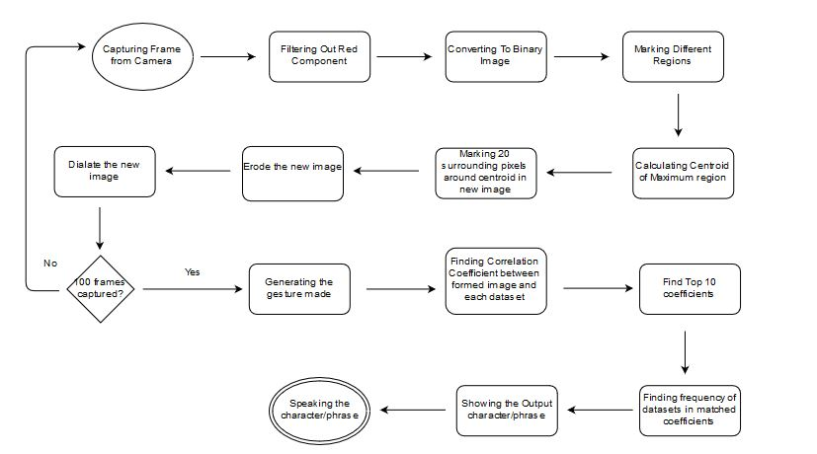
Flowchart for Character Recognition

Slide 6
Character Recognition
Step wise procedure
Capture frame from camera
Taking out the red component of image
Removing noise using median filter
Converting to binary image
Labeling the image using bwlabel();
For each region we calculate the centroids

Slide 7
Character Recognition
In a new blank image we plot the centroid of the red object.
On expiring of the timer the new image contains the plot of the gesture drawn
On this new image we apply open() and close() operations to pre process the image for recognition

Slide 8
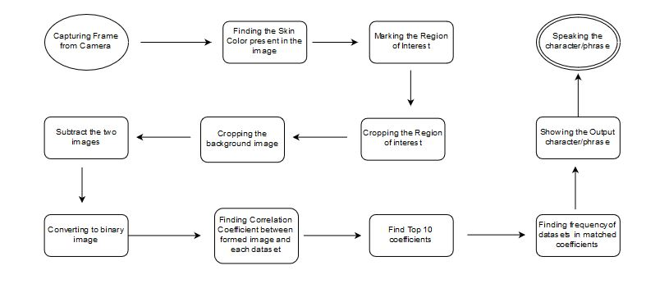
Flowchart for Hand Gesture

Slide 9
Hand Gesture Recognition
Capture frame from webcam
Identifying the pixels consisting of skin color values in the image
Thresholding the image based on skin color values
Identifying the different regions in the image
We find the largest region of interest from the image i.e the hand

Slide 10
Hand Gesture Recognition
We take a snapshot at start representing the background.
On detecting the hand we segment ROI ,an image of 256,256 size surrounding the centroid
We subtract this segmented image from the background image
Now we threshold the image to get only the hand portion in the image

Slide 11
Hand Gesture Recognition
We apply open() and close() operations on the segmented image.
Now we find correlation coefficient between our processed image and the various dataset images.
The top 10 maximum correlation coefficients are selected.
The frequency of matched images are compared and the maximum frequency is the most probable image.

Slide 12
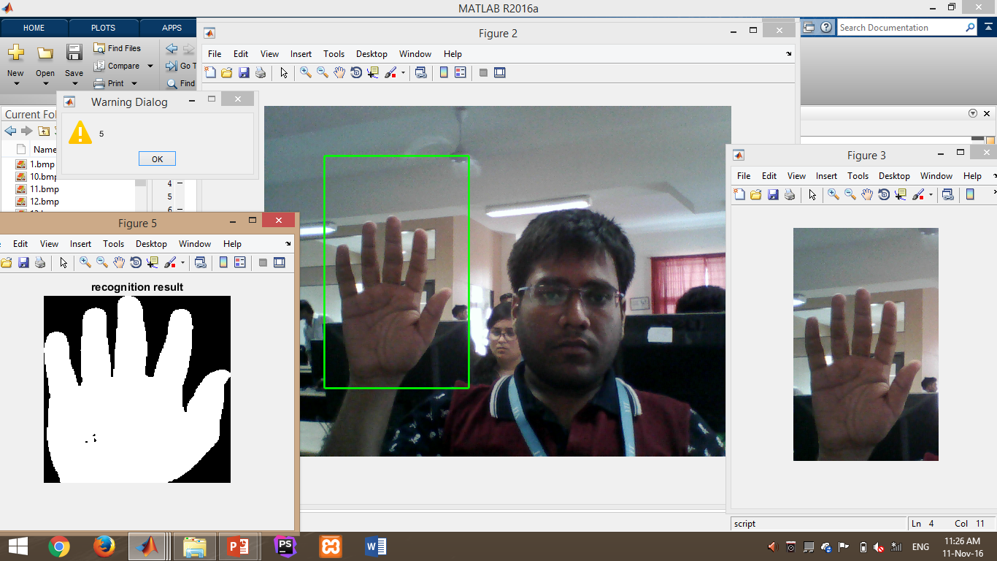
OUTPUT Screenshots for different modules

Slide 13
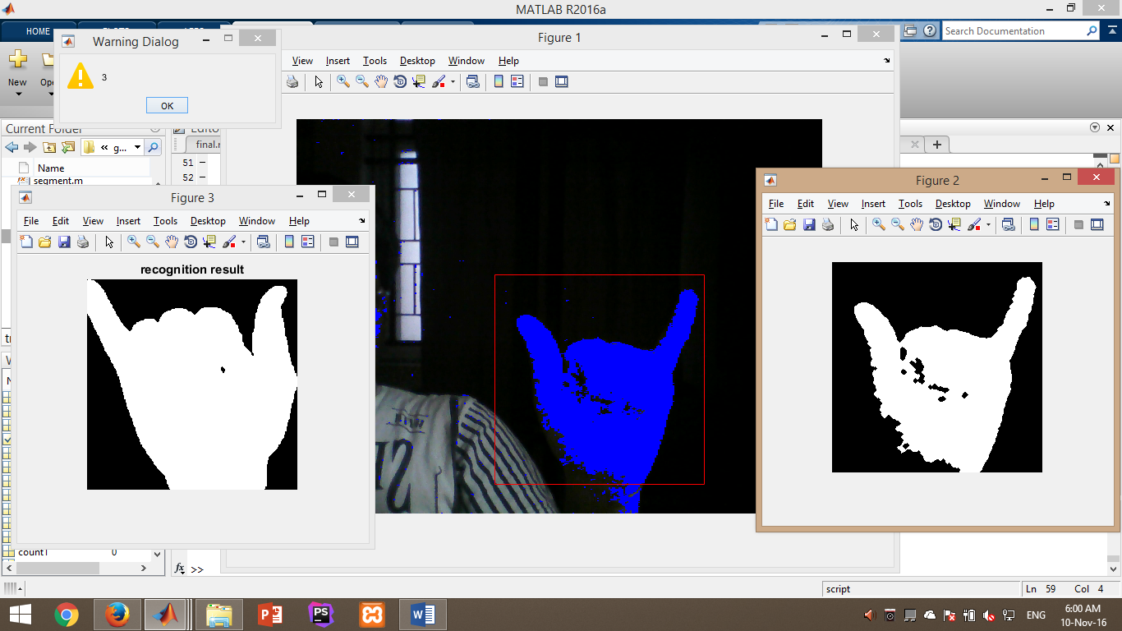
Hand Gesture Recognition By Detecting Skin

Slide 14
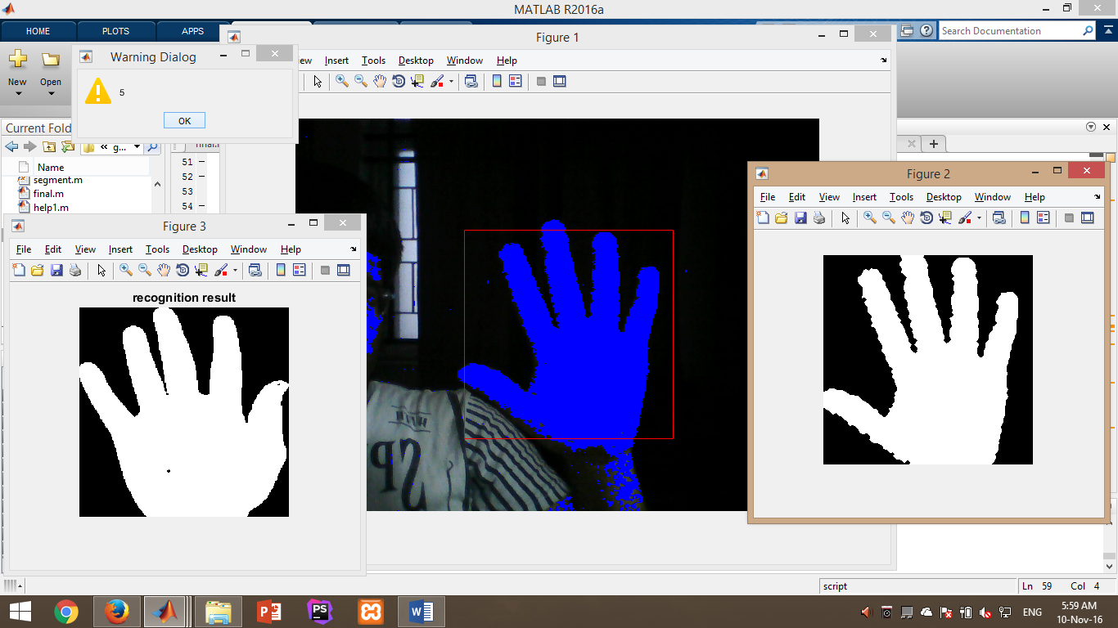
Hand Gesture Recognition By Detecting Skin

Slide 15
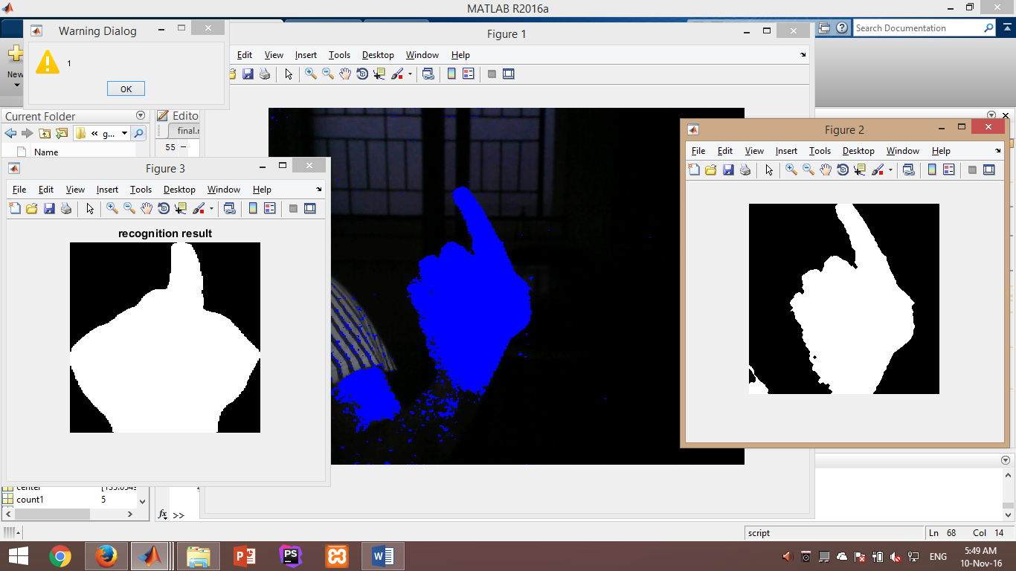
Hand Gesture Recognition By Detecting Skin

Slide 16
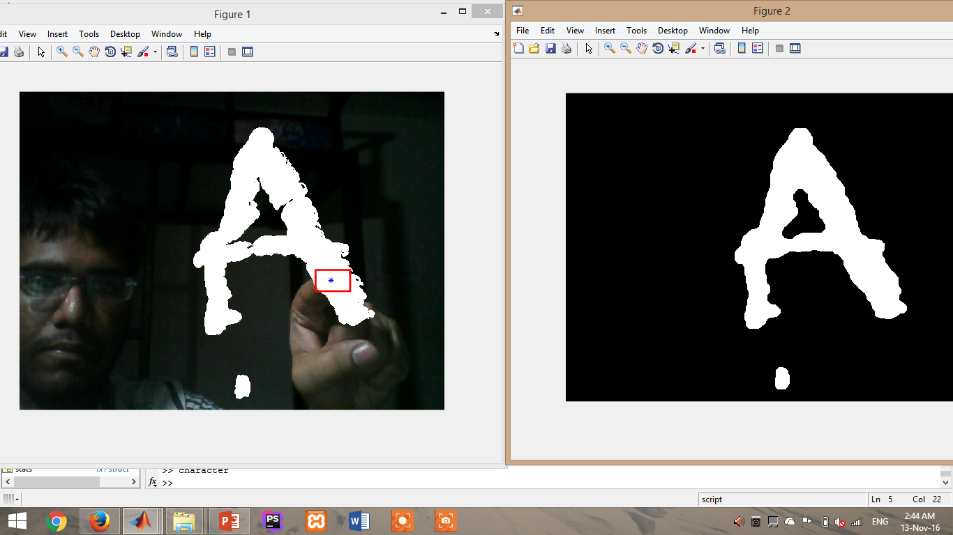

Character Recognition Output

Slide 17
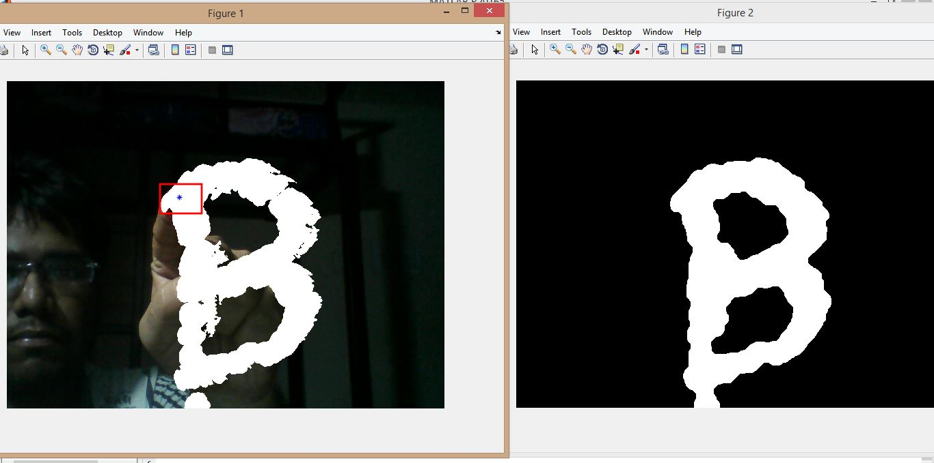
Character Recognition Output

Slide 18
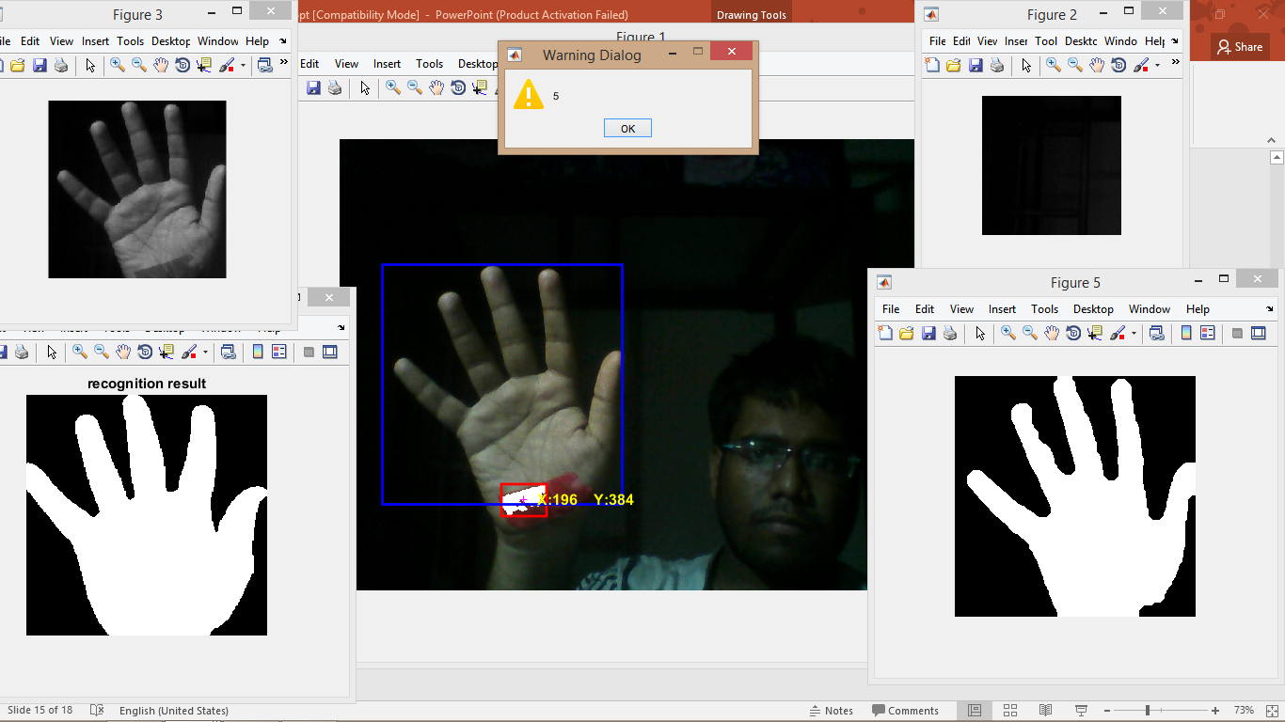
Hand Gesture Recognition By Red Color detection

Slide 19
FUTURE PLANS:
This device can be developed into a device that includes various sign languages in different countries.
We want to make it into a complete product that makes the dumb people to communicate like a normal people.
We want to produce a product for blind people that converts the information in any hand written notes, newspaper or books into a audio signal that these people can here.

